Slide 1

Analysis
Not pleasing
Hard to control the volume
Gel comes out of the tip making a mess
Assemble and disassemble is hard
Mixing tip cap is easy to lose
Customer

Slide 2
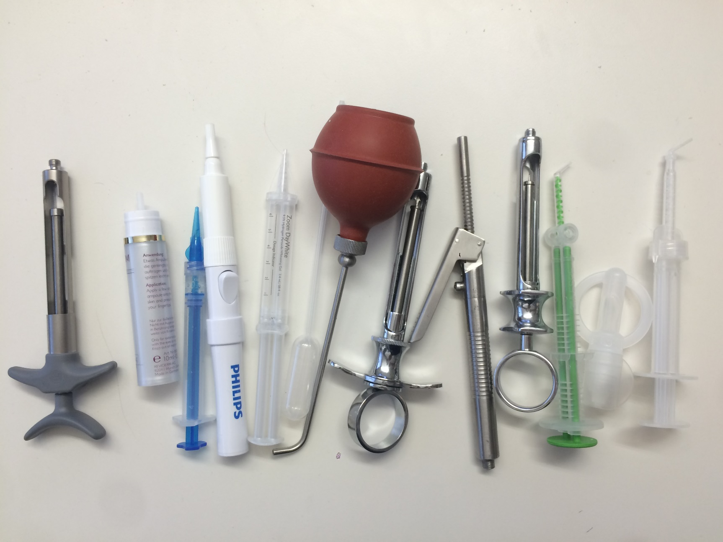
Other Dispenser

Slide 3
Summary of Brainstorm
50 concepts total
Quick closing
Internal and external spring
Pull back with bulge
One way valve
Reduce size of mixing tip
Hard to control the volume
(10)
Control with vision
Control with tactility/Sound
Single use
Glue gun
Gel comes out of the tip making a mess
(10)
Disposable dispenser
More tips or mixing tip caps
Integrate the cap to box
Connect the cap to syringe
Enlarge the cap
Mixing tip cap is easy to lose
(9)
Assemble and disassemble is hard
(8)
One way valve
Integrate the mixing tip and syringe cap
Not pleasing
(13)
Cylinder outer box
Paint syringe
Electrical design
Future style

Slide 4
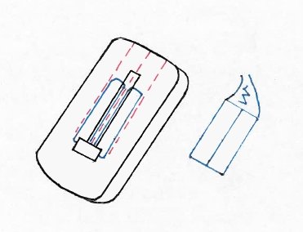
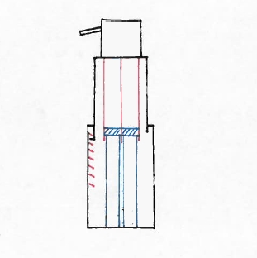
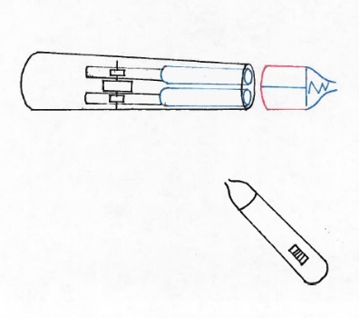
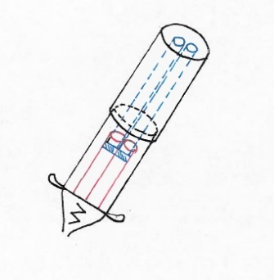
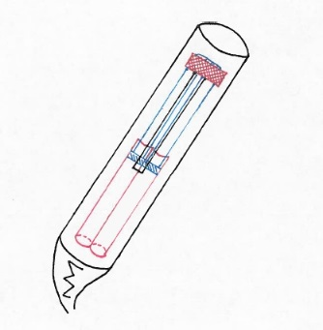
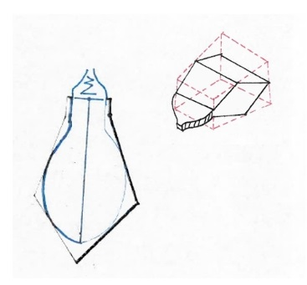
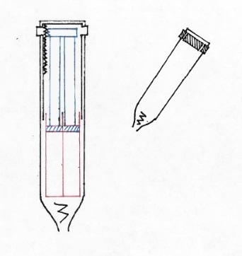
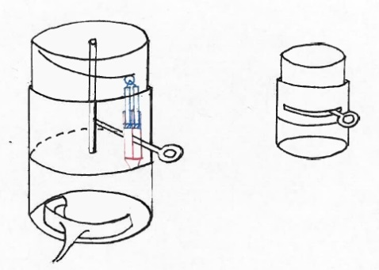
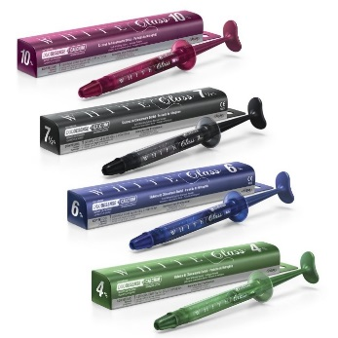
Concepts from Brainstorm
Concept-1 | Concept-2 | Concept-3
Concept-4 | Concept-5 | Concept-6
Concept-7 | Concept-8 | Concept-9/10

Slide 5
Pugh Matrix Analysis
 | Screening Criteria | Ranking |  |  | Weight
 |  | 1 | 3 | 5
Attractiveness | Mess avoid ability | The same as current syringe | User technique dependent | No mess | 17%
 | Volume Control/dosing | Dispense more than full dose | Full dose covering whole mouth piece but inconsistent distribution | Full dose with consistent distribution | 33%
 | Easy use(push force, number of steps, ergonomics and size | Compare them one by one and rank across 1-5 |  |  | 50%
Fit | Cost | More cost than current syringe (5X) | More cost than existing syringe (2.5X) | Comparable cost than existing syringe (1X) | 40%
 | Manufacturability | syringe with cosmetic shell and mechanism | syringe with cosmetic shell | syringe | 20%
 | Maturity | new mixing tip and no model and new mechanism no model | model new mixing tip, new mechanism with model simple possible | mixing tip and no new mechanism with more than two parts | 10%
 | Reliability | more than 2 components are not well understood | no more than 2 components are not well understood | all components are understood well | 30%

Slide 6
Pugh Matrix Result

Slide 7

Winners
Concept 2 | Concept 4

Slide 8
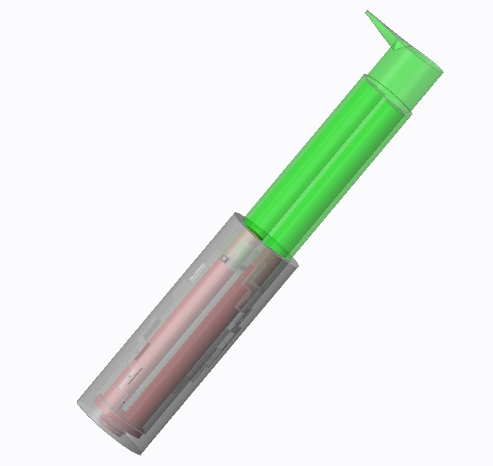
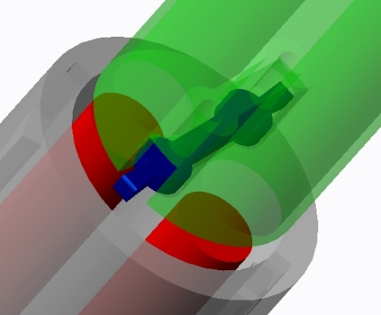
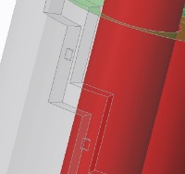
Creo2 Model
Concept-2-multiuse
Description:
Dual barrel
Hypothesis:
Transfer function:
Guide slot shell
plunger
Enablers: it will work since:
Disabler: it might not work since:
bump
Pull-back spring cover

Slide 9
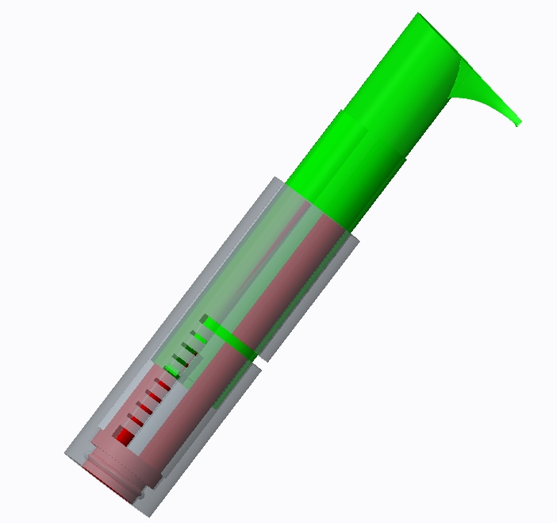
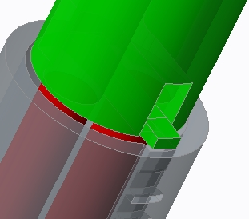
Creo2 Model
Concept-2-single use
Description:
Dual barrel
Hypothesis:
Transfer function:
Guide slot shell
plunger
Enablers: it will work since:
Disabler: it might not work since:
Feedback piece

Slide 10
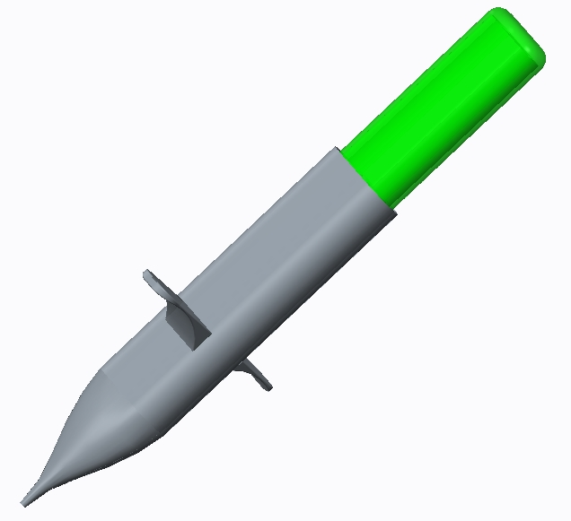
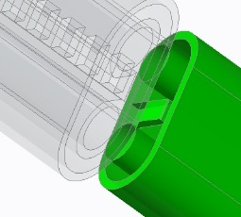
Creo2 Model
Concept-4-single use
Description:
Plunger
Hypothesis:
Transfer function:
Dual barrel
Enablers: it will work since:
Finger holder
Disabler: it might not work since:
Feedback slot
Feedback piece

Slide 11
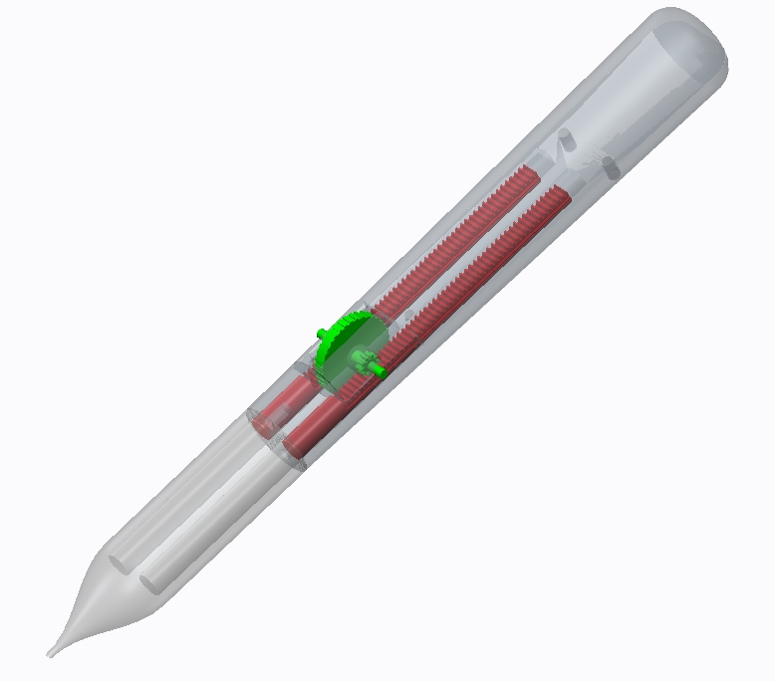
Creo2 Model
Concept-3
Description:
Hypothesis:
Gear rack plunger
Transfer function:
Cosmetics shell
Enablers: it will work since:
Single use barrel
Rolling wheel
Disabler:

Slide 12
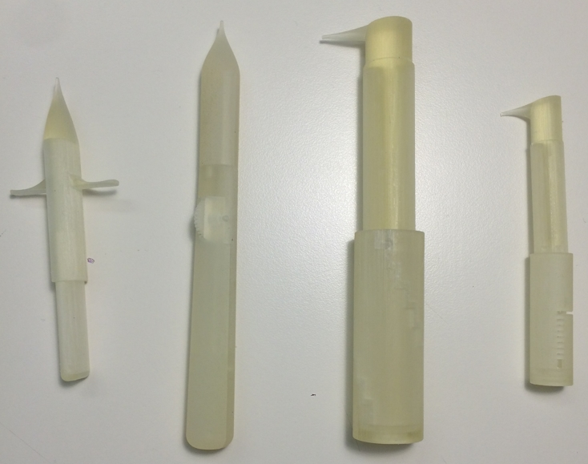
3D Printing Model

